Slide 1
المصطلحات الطبية
المحاضرة 2
Medical terminology is a specialized language used by health care practitioners

Slide 2
Circulatory system terms
Cardio = heart
Endocarditis, myocarditis, pericarditis
Angiography (X-ray of artery)
Venogram (X-ray of veins),
phlebitis (inflammation of vein)

Slide 3
Circulatory System Procedures
Cardiologist - a physician specializing in the cardiovascular system
Electrocardiogram (ECG) –recording of the electrical activity of the heart. (rest and exercise ECG)
Echocardiography - using ultra sound image of the inside of the heart ;
Cardiac catheterization - visualization of coronary arteries.
Coronary angioplasty _ dilatation of coronary arteries

Slide 4
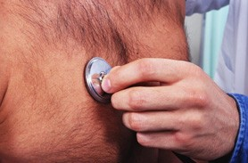
Diseases of CVS
Atherosclerosis-→
fat deposition causing→ narrowing →hypertension,stroke , IHD
Angina pectoris-
pain in the chest increase by stress ,relive by rest & sublingual GTN
2. Myocardial infarction (MI)-
Pain prolong not relive due to complete obstraction of coronary artey

Slide 5
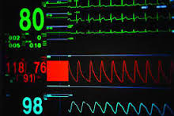
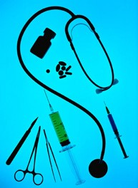
Abnormal Heart rate & Arrhythmia
Bradycardia : slow rate<60
tachycardia : fast rate>100

Slide 6
Musculoskeletal System Diseases
Arthritis & arthralgia– swelling and pain
Osteoporosis – bones lose calcium & density and are easily fractured.
Osteomalacia - “rickets,” not enough calcium is deposited in the bones (rubbery).

Slide 7
Orthopaedics is a surgeon that treat bone fractures, damaged tendons or ligaments.
Rheumatologist –Physicians that treat joint diseases medically
Procedures
Arthroscopy - visualize surfaces of bones entering into a joint, find tears & inflammation.
Electromyography - a recording of muscle electrical activity is useful in evaluating causes of paralysis.

Slide 8
Cancer Terms
oncology (study of tumors)
oncologist is a cancer specialist
Good news | Bad news
Benign | Malignant
Low grade | High grade
Radiosensitive | Radioresistant
No metastases | metastases
Well differentiated | Poorly differentiated
Negative nodes | Positive nodes
In remission | Relapse
Surgically resectable | Inoperable

Slide 9
Grading and staging
Grading I - IV, to describe tissue differentiation.
well differentiated → mimic the original tissue
poorly differentiated → not
The stage of the tumor determines if the tumor has invaded surrounding tissue, lymphatics ,metastasized using the letters T, N, M “T” indicates size of tumor; “N” lymph nodes; “M” metastasized
Imaging (CT, MRI) is also an essential tool.
Carcinogens are cancer causing agents. Include:
radiation, chemicals, drugs , viruses.

Slide 10
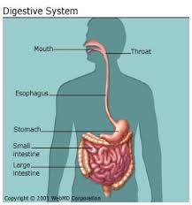
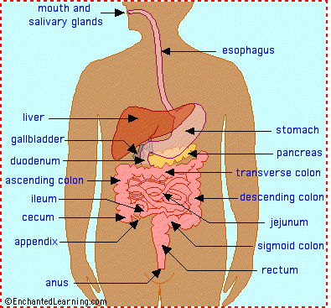
Digestive system terms

Slide 11
Gastr/o | Stomach | Gastritis, Gastrectomy
Hepat/o | Liver | Hepatitis (inflammation of), hepatoma (tumor of)
Chol/e | Gall, bile | Cholecystitis, cholecystectomy (inflammation of, removal of gallbladder)
Lapar/o | Abdominal wall | Laparotomy (cutting into the abdomen)
-centesis | To puncture | Abdominocentesis (puncturing and draining)

Slide 12
1. Jaundice - Yellowing of the skin and conjunctiva
caused by : hemolysis or hepatitis or obstruction of bile duct
2. Gastroesophageal Reflux Disease (GERD) -“heartburn” due to Weakness of the valve between the esophagus and stomach .
3. Dysphagia - Difficulty swallowing.
4. Peritonitis - Inflammation of the lining of the abdominal cavity.

Slide 13
Digestive System Procedures/specialists
Gastroenterologist – a physician specializing in digestive system
Endoscopy - visualize the esophagus, stomach ,duodenum and large bowel.
Ultrasonography visualize internal organs of abdominal and pelvic organs, such as the pregnant uterus.

Slide 14
Respiratory system terms

Slide 15
Rhin/o | Nose | Rhinitis, inflammation
Laryng/o | Larynx, “voice box”* | Laryngectomy (surgically removing the larynx)
Trache/o | Trachea | Tracheostomy
Bronch/o | Lung air passageways | Bronchoscopy (looking into the bronchi)
Pne/u, -pnea | Breath, air, lung | Tachypnea, dyspnea, apnea (accelerated, difficult, cessation of breathing)

Slide 16
Respiratory System Diseases
Epistaxis - a nose bleed
(COPD) Chronic Obstructive Pulmonary Disease :
emphysema, results in progressive destruction of the lungs (as smokers).
chronic bronchitis
Bronchial asthma (Narrow + viscid sputum, hypertrophy)
Pulmonary function tests : peak flow meter, Spirometers
Atelectasis - a collapsed lung.

Slide 17
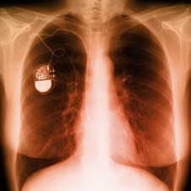
Respiratory System Procedures
Chest X-ray - image the chest by AP, Lateral , oblique views
To assess : Heart size and shape, valves , Pacemaker,

Slide 18
Pulmonary angiography - special X-rays of the vessels of the lungs.
Laryngoscopy - visual examination of the larynx.
Inhalers and Nebulizers : device for broncho-dilatation
Endotracheal intubation - passing a special air-tube into the trachea so oxygen can be reliably supplied directly to the lungs .
Tracheostomy direct cut the treachea and put a tube in emergency with upper airway obst.

Slide 19
Genital -Urinary system terms

Slide 20
Nephr/o, ren/o | Kidney | Nephritis, renal artery
Cyst/o | Bladder | Cystitis, cystectomy
Ur/o, -uria | Urine | Polyuria, anuria, Oliguria,dysuria

Slide 21
Nephrolith – a kidney stone.
Incontinence: involuntary release of urine “bedwetting.”
Nephrologist - a physician specializing in kidney diseases.
Cystoscopy : visualize the urinary bladder with a scope
Intravenous pyelogram – special contrast X-rays showing the kidney, ureter and bladder.
Dialysis – a cleansing the blood of waste products in individuals with complete kidney failure
Lithotripsy - Crushing kidney stones with sound waves.

Slide 22
Male Reproductive System Diseases
Varicocele - dilated and twisted veins of the testis.
Benign prostatic hypertrophy (BPH) - swelling of the prostate gland which surrounds the base of the male bladder.
Transurethral resection of the prostate (TURP) - the surgical cure for BPH, to relieve obstruction
Prostate Specific Antigen (PSA) – PSA is a marker for prostate cancer.

Slide 23
Obstetrician -. A physician specializing in the diagnosis and management of pregnancy and delivering babies.
Gynecologist - a physician specializing in diseases of the female reproductive system and surgery of this area.
Venereal disease - A sexually transmitted infectious disease
Pelvic inflammatory disease (PID) –inflammation of the vagina, the uterus, and the uterine tubes
Dilatation and curettage (D & C) - remove residual tissue remaining in the uterus .
Episiotomy – a surgical procedure cutting into the perineal area, the area between the vagina and anus to enhance labor

Slide 24
Complications of pregnancy
Placenta previa- blocking the entrance to the birth canal.
Eclampsia : hypertension, convulsions and coma.
Ectopic pregnancy- A pregnancy implanted outside of the uterus as in Fallopian tube

Slide 25
Pregnancy
Nulligravida (never pregnant),
primigravida (first-time pregnant)
multigravida (many pregnancies)-
Prepartum, postpartum (before and after delivery)
Abortion : loss of baby in 1st or 2nd trimester of pregnancy
Still birth : dead baby in 3rd trimester (complet)
Normal vaginal delivery (NVD)
Caesarean section ( CS)

